Slide 1
Enhancing Faculty Research: A Few Ideas
Dr. Munir Quddus
Dean and Professor of Economics
PVAMU College of Business
HBCU Business Dean’s Summit | June 2-4, 2022 | Dallas, TX

Slide 2
The Challenge/Problem…
B-Schools, especially those interested in AACSB accreditation/reaffirmation
“Intellectual Contributions (ICs)” or “Research” broadly defined is a critical part of the AACSB Standards.
The most recent version – 2020 standards – reinforce this by talking about: a) research in “high quality” outlets, b) importance of measuring the impact of research
How do the standards implement/enforce this emphasis on research?

Slide 3
AACSB Standard 3:

Slide 4
AACSB Standard 8

Slide 5
How do the AACSB Standards ensure students are taught by research-active faculty?
Table 3. 1 on “Faculty Sufficiency and Qualifications” requires that the school reports for each faculty and each major (such as Accounting) data to demonstrate that a “minimum number of qualified faculty” are teaching in the classroom.
Table 8.1 specifies minimum number of “faculty producing intellectual contributions” in each major/discipline.
To “sustain currency and relevancy” the 4 type of classifications (status) based on individual faculty qualifications are,
SA – Scholarly Academic [normally Ph.D. faculty, active in research]
PA – Practice Academic [normally Ph.D. faculty, doing some research, whose focus has shifted to more association with business and industry]
SP – Scholarly Practitioner [normally non-Ph.D. faculty, with business and industry experience, doing some research]
IP – Instructional Practitioner [normally non-Ph.D. faculty, with interest in only teaching]

Slide 6
AACSB Guidelines on Research and Scholarship …for each major

Slide 7
How is faculty effort measured?
Table 3.1 (formerly 15.1) gives the School the option to measure faculty efforts by the number of courses taught, or by the “% of time devoted to mission.”
For example, for tenured (T) and tenure-track (TT) faculty, PVAMU defined 3+3 teaching load as 100% effort to the mission.
For faculty teaching in a specific discipline (say, Acct), these minimums [40%; 90%] in “qualified faculty” must apply.
Table 3.1 also requires data to show that in each discipline, a minimum number (60%) of faculty are “participating” -- they are engaged in other aspects of the school’s life as part of faculty governance, in addition to teaching. [the minimum is higher at 75% for the College as a unit]

Slide 8
Step 1: Define your SA, PA, SP, IP and (A)
Each school is expected to define the four status - SA, PA, SP, IP - as it relates to its mission; many schools have used the “at least two PRJs in five years” as the minimum for SA.
To define each of the faculty competency or “status” based on research, PVAMU has moved to a “Point System.”
A point system has a few advantages. You are able to assign different weights depending on quality of outlet and impact, and time commitment:
a) Publications in “high quality” PRJs receive higher weights, and
b) The point matrix can distinguish between various types of “intellectual contributions” which AACSB recognizes.
For Scholarly Academic (SA), PVAMU standards are: “A doctoral degree with at least 225 points of ICs (Levels A and B combined), including a minimum of 100 points from Level A (PRJs only), during the 5-year evaluation period.”

Slide 9
Table – Criteria for Faculty Academic Qualification Classification
Normally Terminal Degree | Scholarly Academics (SA) | Practice Academics (PA)
 | COB Standards: Doctoral degree earned in the 5-year evaluation period, or Doctoral degree and at least 225 points of ICs (Levels A and B combined), including a minimum of 100 points from Level A (PRJs only), during the 5-year evaluation period. | COB Standards: Doctoral degree and tenure, and At least 225 points of ICs and PCs combined, including a minimum of 125 points from PCs (engagement with business) during the 5-year evaluation period.
Normally Master’s Degree | Scholarly Practitioners (SP) | Instructional Practitioners (IP)
 | COB Standards: Relevant Masters degree At least 150 points of ICs and PCs combined, including a minimum of 75 points from ICs in the 5-year evaluation period. | COB Standards: Relevant Masters degree At least 100 points of ICs and PCs combined in the 5-year evaluation period.

Slide 10
PVAMU Point Matrix – Intellectual Contributions
Group | No | Intellectual Contribution Activity | Points
A | 1 | High-quality peer-reviewed journal (PRJ) article | 200
 | 2 | PRJ article | 100
B | 1 | Scholarly book including a new textbook | 200
 | 2 | Research grant funded by an external organization [NSF, DOD, Homeland Security, etc.] | 100
 | 3 | Textbook (revised edition) | 50
 | 4 | Chapter/article in a research/scholarly book | 50
 | 5 | Complete manuscript in conference proceedings | 50
 | 6 | Chapter in a case/reading book | 35
 | 7 | Study guides, instructor’s manual, or other supplementary material in teaching | 35
 | 8 | Editor reviewed article/case [not blind reviewed] | 35
 | 9 | Monograph sponsored by a reputable organization | 35
 | 10 | Abstract only in conference proceedings | 25
 | 11 | External grant proposal including a successful internal seed grant | 25
 | 12 | Consulting report | 25
 | 13 | Online working paper | 25
 | 14 | Conference presentation | 15
 | 15 | Reviewer report of an article submitted for publication in a PRJ | 15
 | 16 | COB research symposium presentation | 15
 | 17 | Other written intellectual contribution | 15
 | 18 | COB mini-grant or a campus grant for a research project | 15
 | 19 | Other research activities: for example, research awards and recognitions such as the best paper award, COB Dean’s Excellence in Research award, competitive summer mini-grants, appointment as a faculty fellow, appointment as a member or external in a doctoral dissertation team, etc. | 15-50

Slide 11
Challenge #1
When Ph.D. faculty are underperforming
Strategies:
Create incentives for existing Associate or full Professors (tenured) who have been “inactive” in research [may be in the “PA” or “additional” status] to re-activate their research to attain SA or PA status.
Work to ensure that each new assistant professor (and associate professors) is regularly publishing in peer- reviewed journals (PRJs); if someone is falling behind, intervene with mentoring and support.
The most budget-friendly and efficient strategy/intervention is adopt the role of a matchmaker - bring faculty together to create “research teams or communities.” The inactive senior and research-active junior faculty can team up; faculty across disciplines can team up for joint research.
However, the most powerful teams are often those where TT and NTT faculty work together, so that with each success (PRJ publication), the number of SP faculty rises, and the number of “IP or additional” faculty declines.
Having a few superstars is a always good thing, but it is better if a broad swath of faculty is publishing in respectable outlets, often in research teams. The emphasis of AACSB accreditation is on the overall “faculty portfolio” or shared/collective success in research, since the goal is to ensure that students (at all levels) are taught by faculty who maintain, “currency and relevancy” in their respective area of expertise.
Last but not the least, if the provost is agreeable and provides new faculty lines, hire new faculty with an established research record [or, who are fresh PhDs.]
SA Faculty < 40%

Slide 12
Challenge #2
When both Ph.D. faculty and Professional faculty are underperforming in research
Strategies:
Create incentives for existing Associate or full Professors (tenured) who have been “inactive” in research to re-activate with research to attain SA or SP status. This would reduce faculty with “additional or A status” and those with IP status, and increase the number of SA and SP faculty.
The most effective strategy may be to pro-actively bring faculty together in research groups or teams, where research-active Ph.D. faculty take professional faculty “under their wings” and mentor them in research. The professional faculty have important skills – strong work ethics, desire to learn, and good writing skills. It is recommended that you create incentives for both the mentor and the mentee.
It is very important that the higher research standards are “written” and used for “tenure and promotion” in faculty handbook; is part of the instrument used for annual performance evaluations; and importantly, in “guidelines on merit raise” recommendations. For example, the guidelines can state that to receive a “merit raise,” one must be academically qualified by AACSB standards.
Create a culture supportive of research – recognize faculty successes, whether it is a new publication, promotion, or receipt of a grant. Example: I share these success stories with all faculty and with the Advisory Board, and sometimes with the Provost and the President.
If the provost is agreeable and budget allows, hire new faculty with an established research record (SA), or newly minted Ph.Ds.
SA+ PA + SP + IP < 90%

Slide 13
Strategies Used at PVAMU COB to Broaden/Enhance Faculty Research and Publications…

Slide 14
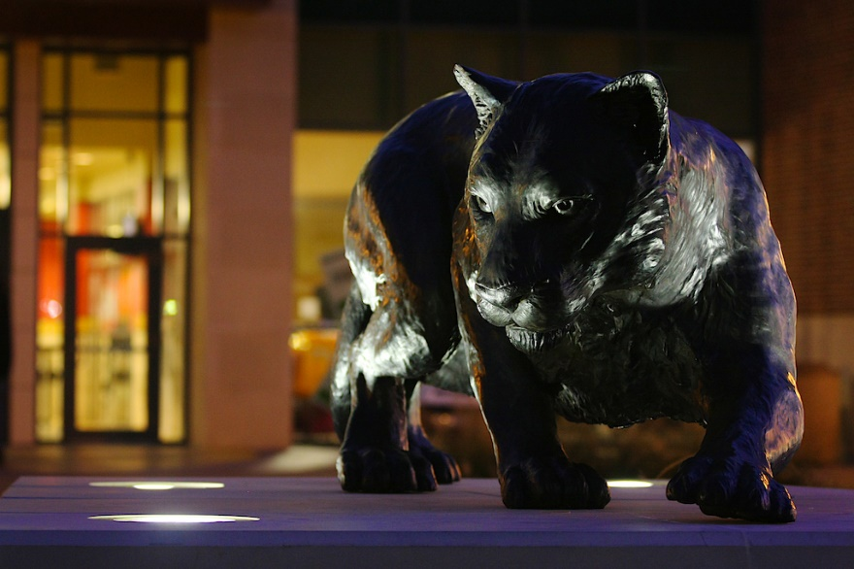
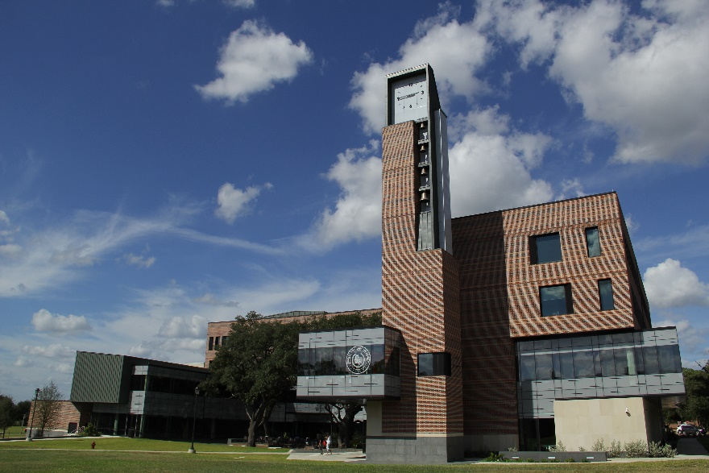
www.pvamu.edu/business

